Slide 1
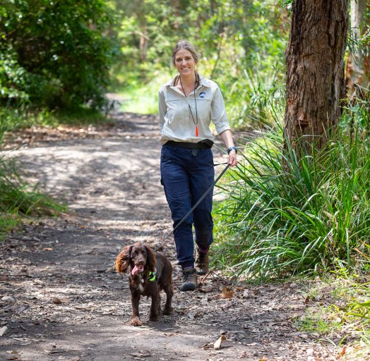
Dogs NSW SWWP proudly presents…
Naiomi Finlayson (Indago Environmental) – a Conservation Detection Dog handler and trainer, and experienced environmental manager.
Naiomi will chat about her work, her dogs (Henry and Daisy) and their training to detect invasive and/or threatened plants and animals.
Naiomi, Henry and Daisy will then demonstrate their invaluable skills!
Naiomi and Daisy in Newcastle, NSW
Held at the GSD Building - Sunday 2 March 2025 | 10.30am -12.30pm | entry via Showmanager - $10 (opening date to be advised)

